Slide 1
NLP Investigation Machine Translation Eric Rodgers

Slide 2
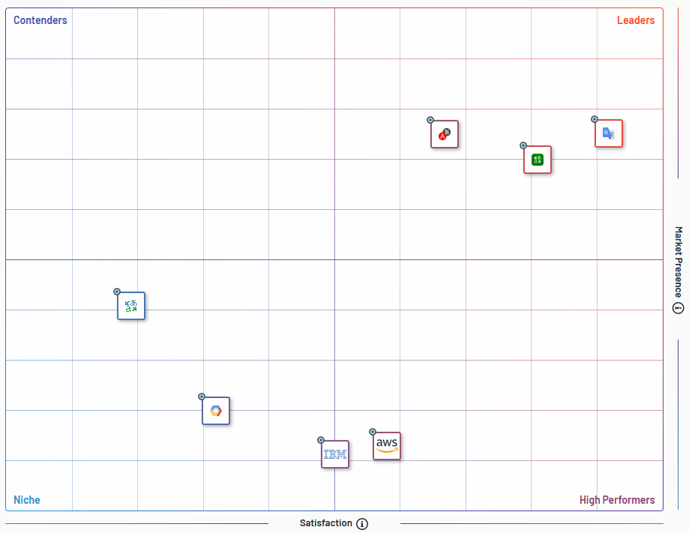
Best Machine Translation Software
Within the market of Machine Translation, there are 7 key players. Services like Google Translate, Yandex and Microsoft Translator are market leaders among there peers.
Google (the focus of this presentation) remains the leader through their collection of data techniques to better offer translation services all for the low price of our privacy through our internet data.
Notes:
https://expandedramblings.com/index.php/yelp-statistics/

Slide 3
Machine Translation Rules to be Successful
A translator needs to interpret all elements to understand the inter relationships within a sentence.
Expertise in grammar as well as semantics and sentence structure in both the referenced language and target language.
The translator must understand and be familiar with local regional meanings of words.

Slide 4
Google Translate
The How-It Works
OLD PROCESS
CURRENT PROCESS
Text to be Translated
Text to be Translated
Referenced
Linguistic Sources
Neural Machine Translation
Whole Sentence Rather then single word translation
Translate Text to English
Cross-referencing target language documents
DOCS
Translated Text
Translated Text

Slide 5
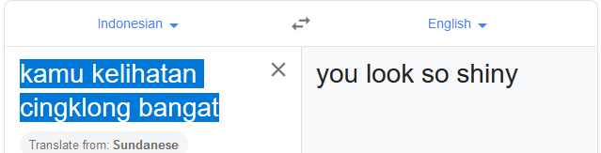
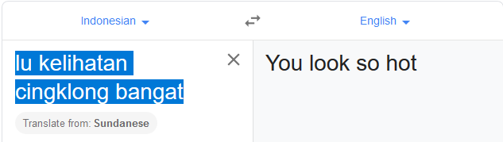
A Try @ Slang with Google Translation
Notes:
It even translates slang successfully!

Slide 6

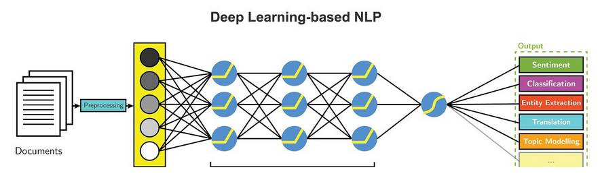
Google Deep Learning
Requires
Large Training Data
Multicore CPU/GPUs
Provides
Flexibility and learnable framework for visual and linguistic information
Representation learning attempts to automatically learn good features rather then typical manually built models

Slide 7
Other Machine Translation Technologies
Rule Based Machine
Relies on rules and dictionaries
Requires lexicons with morphological, syntactic and semantic information
Users can add custom translations to dictionaries
Pros & Cons
+ Consistent
+ Knows Grammatical Rules
+ High Performance
- Lack of fluency
- Exceptions to rules harder to handle

Slide 8
Other Machine Translation Technologies cont’d
Statistical
Stem from monolingual and bilingual corpora
Relies on existing multilingual corpora
Requires intensive CPU hardware
Pros & Cons
+ Good fluency
+ Good at exception to the rules
- Unpredictable quality
- Does not know grammar
- High CPU and Disk Requirements

Slide 9
References
Best Machine Translation Software. (n.d.). Retrieved from https://www.g2.com/categories/machine-translation
McGuire, N. (2019, May 1). How Accurate is Google Translate in 2019? Retrieved from https://www.argotrans.com/blog/accurate-google-translate-2019/
Le, J. (2018, June 6). The 7 NLP Techniques That Will Change How You Communicate in the Future (Part I). Retrieved from https://heartbeat.fritz.ai/the-7-nlp-techniques-that-will-change-how-you-communicate-in-the-future-part-i-f0114b2f0497
What is Machine Translation? Rule Based Machine Translation vs. Statistical Machine Translation. (n.d.). Retrieved from https://www.systransoft.com/systran/translation-technology/what-is-machine-translation/

